Slide 1
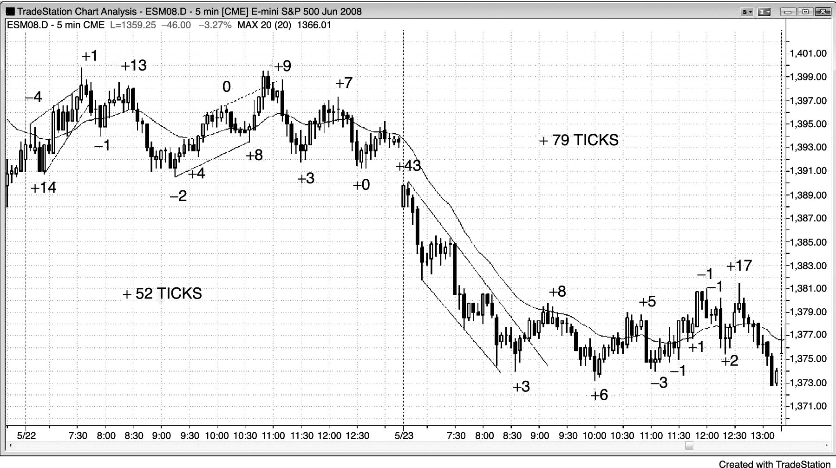
FIGURE 15.1 Always-In Swing Trading

Slide 2
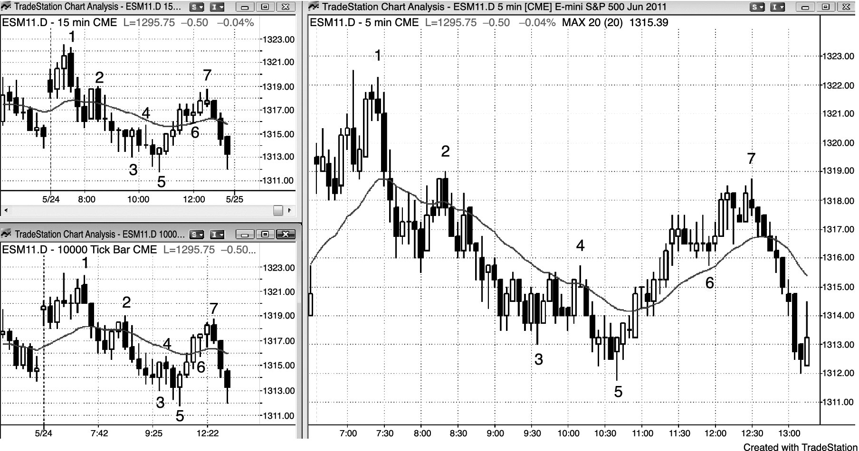
FIGURE 15.2 Higher Time Frame Charts

Slide 3
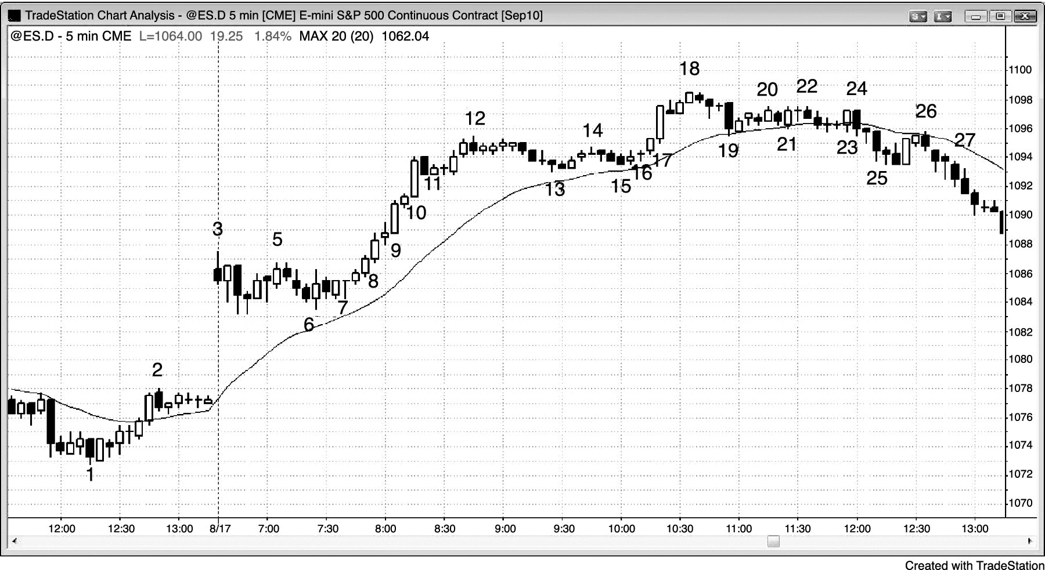
FIGURE 15.3 Gap Up, Then Pullback

Slide 4
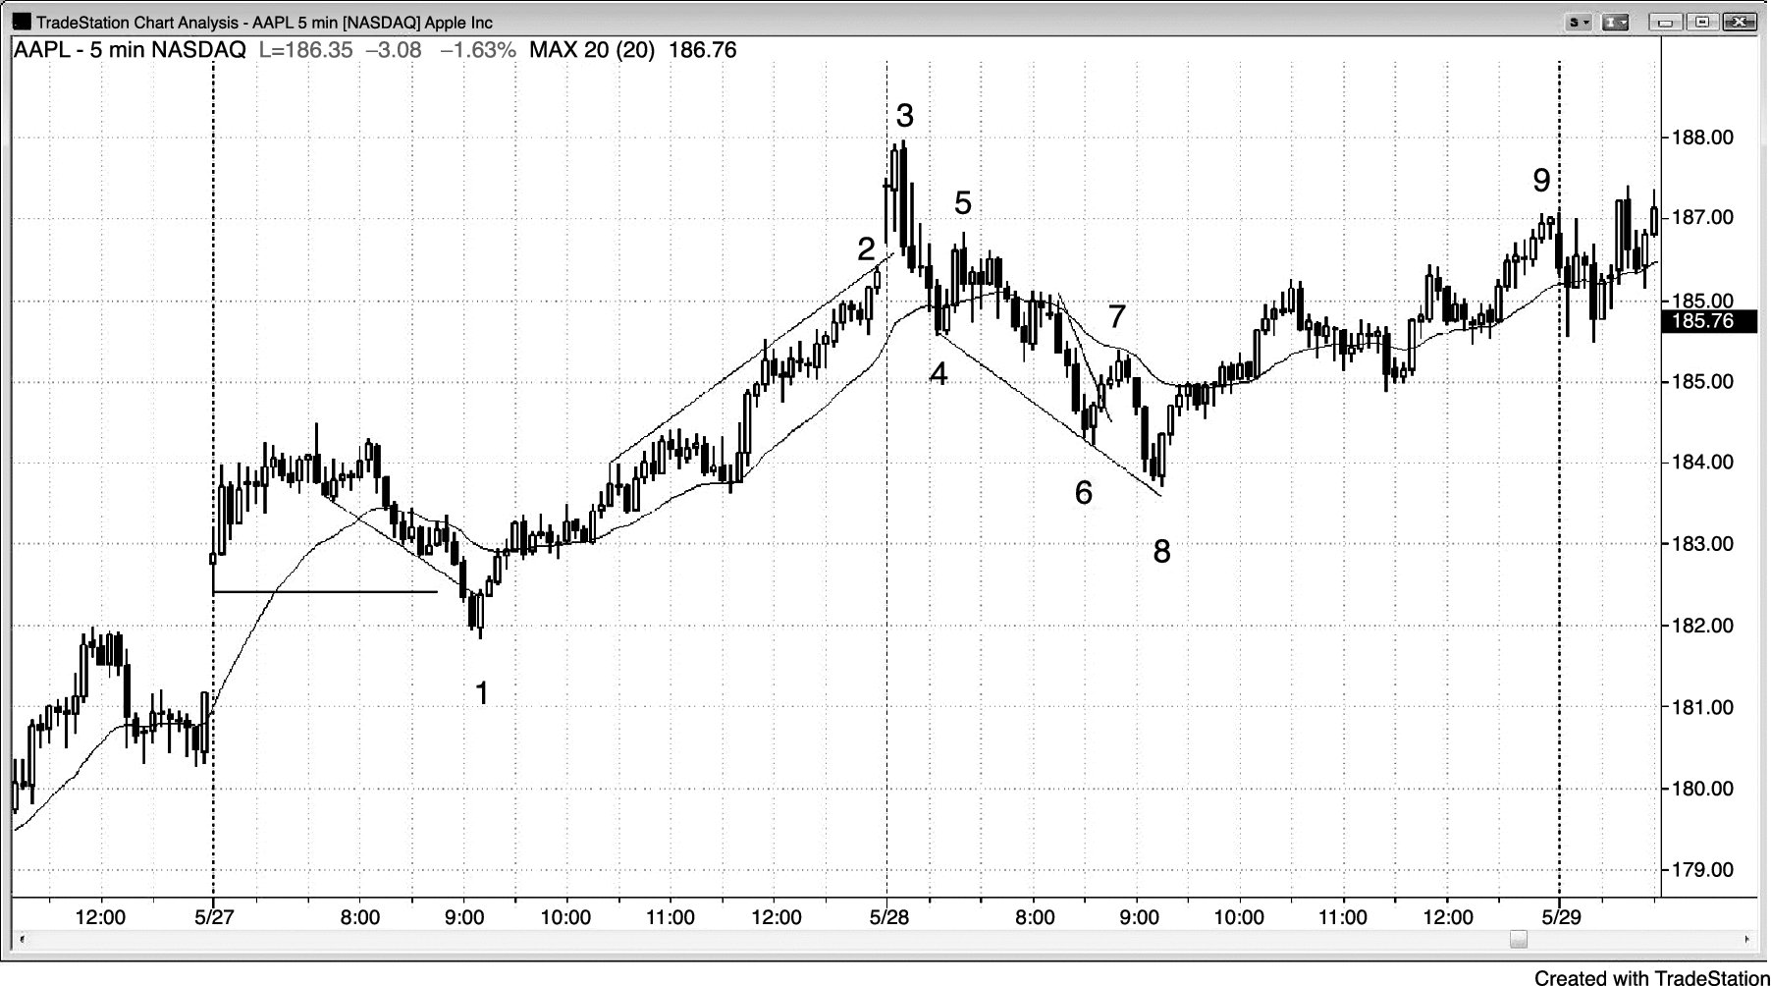
FIGURE 15.4 Look for Early Swing Setups

Slide 5
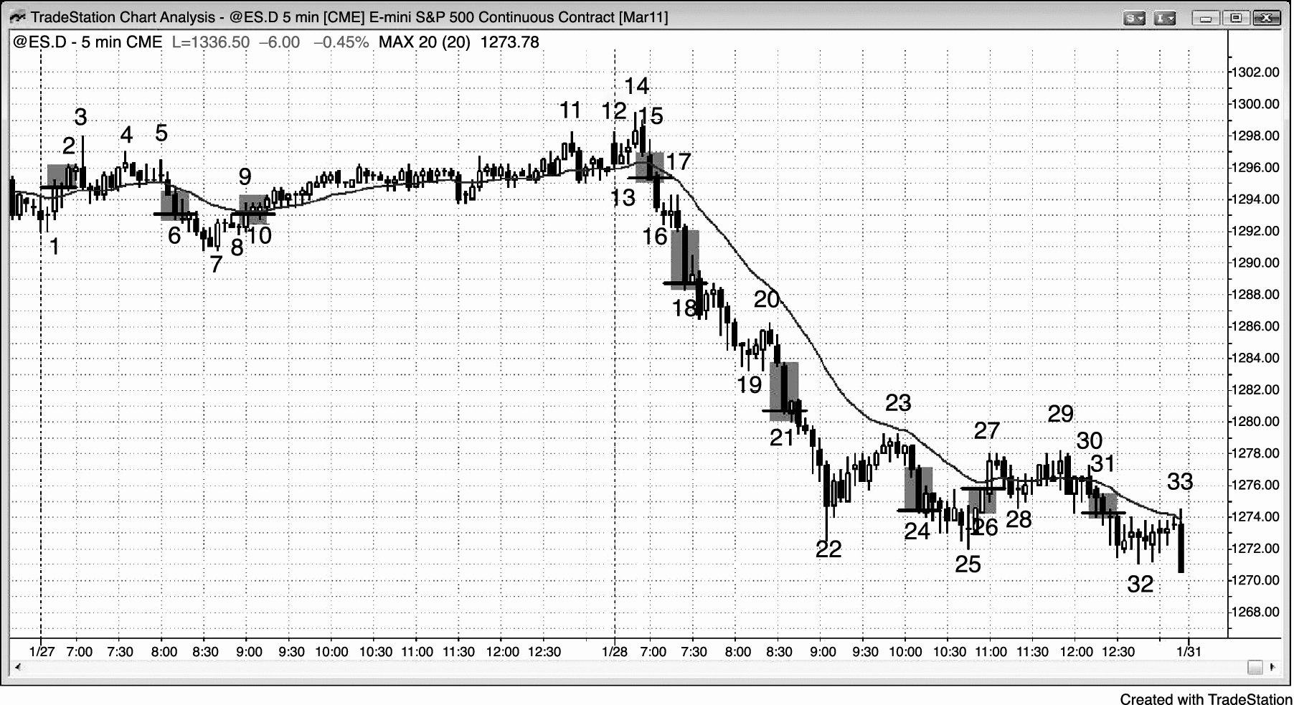
FIGURE 15.5 Follow-Through Is Often Likely

Slide 6
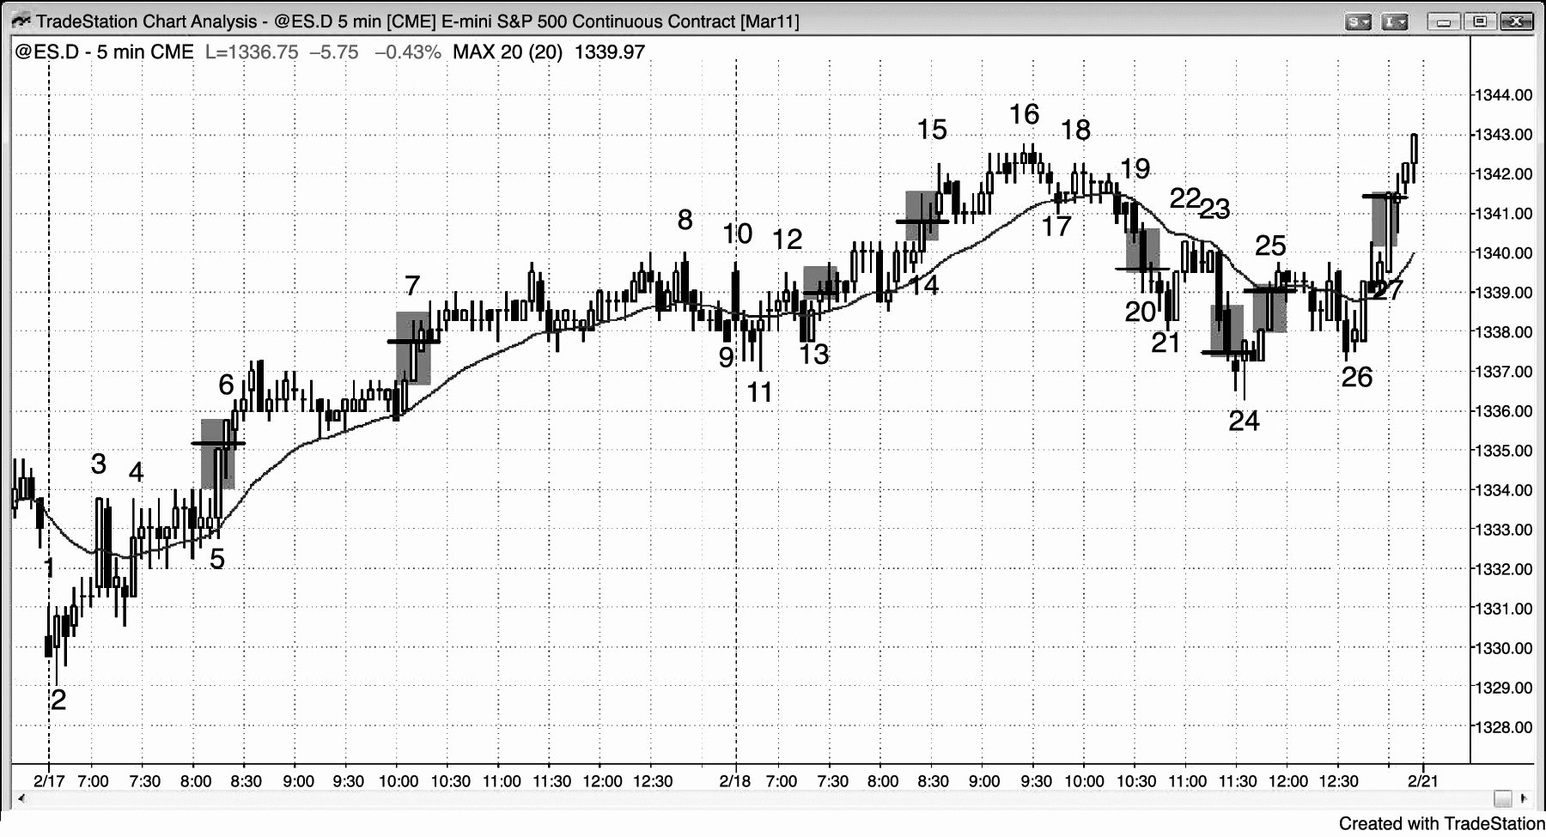
FIGURE 15.6 Always-In Setups

